Slide 1

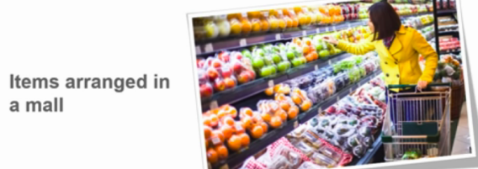
Clustering

Slide 2
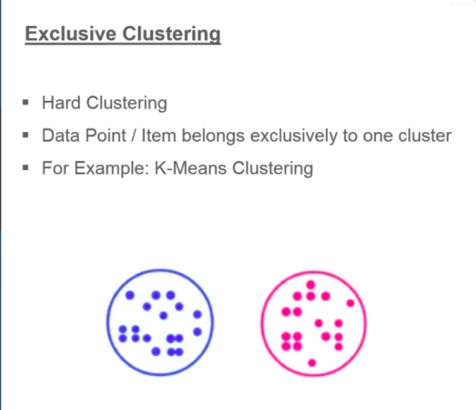
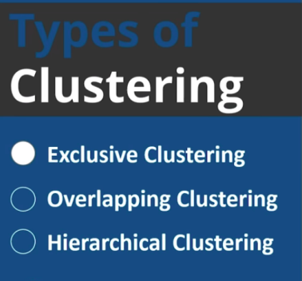
Type of Clustering

Slide 3
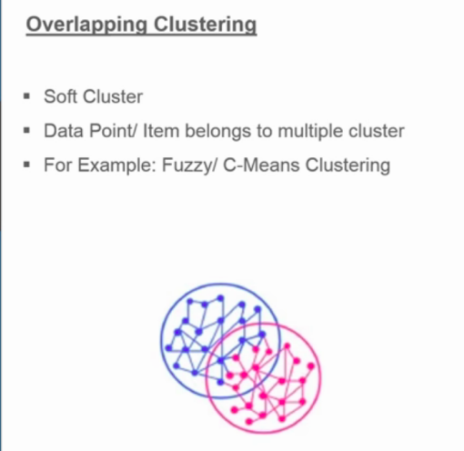
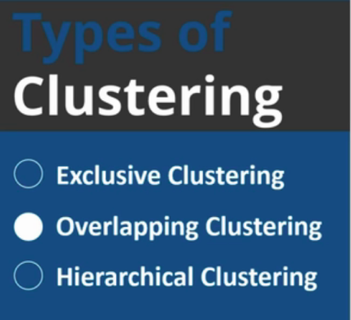

Slide 4
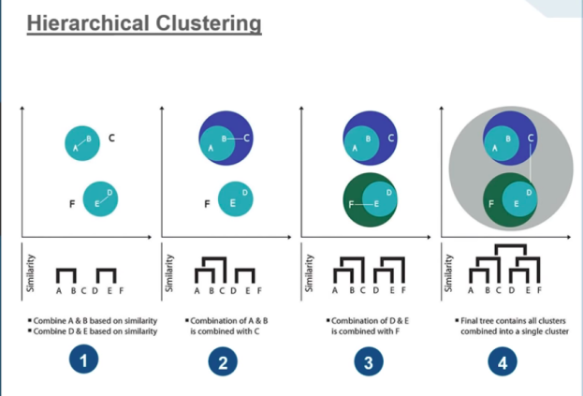
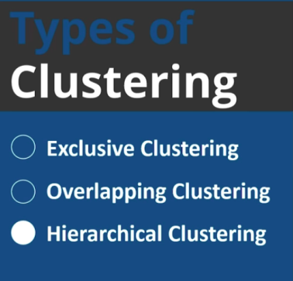

Slide 5
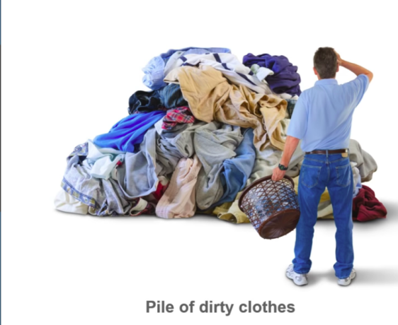
What is K-Means Clustering
K-means is a clustering algorithm whose main goal is to group similar element or data points into a cluster
K-means represent the number of clusters

Slide 6
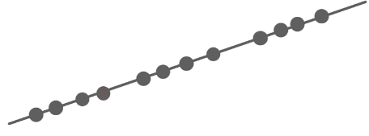
Step1: Select the number of clusters to be identified
K=3
Step 2: Randomly select 3 distinct data point
Step 3: Meausre the distance between 1st point and selected 3 clusters

Slide 7
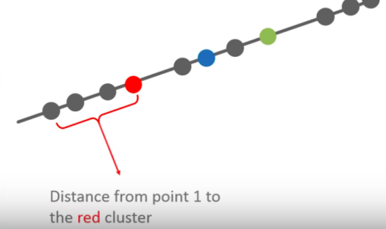
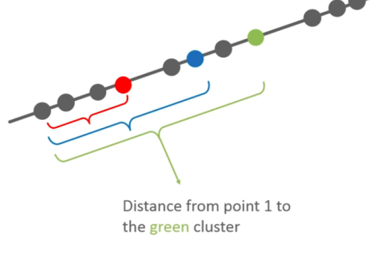
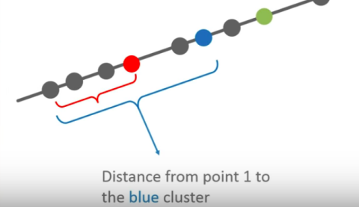

Slide 8
Example
Let’s take an example of Cricket
  Task: Identify bowlers and batsmen
    The data contains runs and wickets gained in the last 10 matches
    So, the bowler will have more wickets and the batsmen will have higher runs Scores

Slide 9
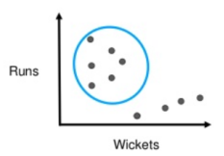
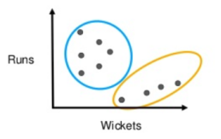
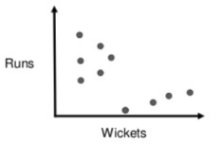
Assign Data Points
Here, we have our
Dataset with
x and y coordinates.
Now, we want to cluster
this data using K-Means
Cluster 1
We can see that this
cluster has players
with high
runs and low wickets
Cluster 2
And here, we can see that
this cluster has players
With high wickets and
low wickets

Slide 10
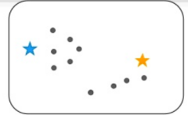
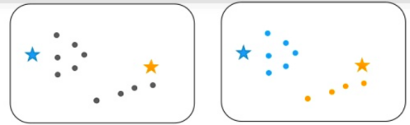
Consider the same data set of cricket
Solve the problem using K-Means
Initially, two centroids are assigned randomly
Euclidean distance to find out which centroid is closest to each data point and the data points are assigned to the corresponding centroids

Slide 11
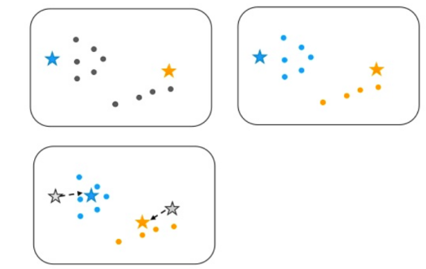
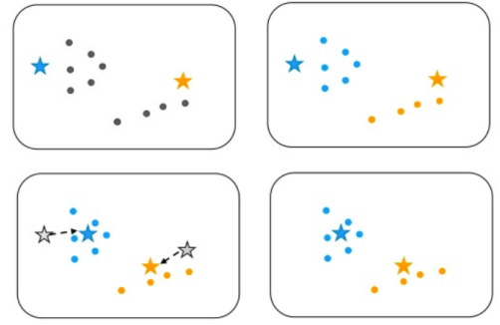
Reposition the two centroids for optimization.
The process is iteratively repeated until our centroids become static

Slide 12
Mathematical Steps
Set the cluster no (K)
Randomly choose the k mean value
Find the nearest number to mean and put it the cluster
Repeat the above step until we get same mean value.
S={2,3,4,10,11,12,20,25,30}
In this example put k=2
Choose 2 mean value randomly from the set.

Slide 13
Iteration3
M1={2+3+4+10}/4= 4.75 m2={11+12+ 20+25+30}/5=19.6
M1=5 m2=20
K1={2,3,4,10,11,12}
k2={ 20,25,30}
…..
…
M1=7 m2=25
Iteration1
m1=2 and m2=12
K1={2,3,4,}
K2={10,12, 20,25,30}
Iteration2
M1=(2+3+ 4)/3=3
m2=(10+12+ 20+25+30)/6=18
M1=3 and m2=18
k1={2,3,4,10}
k2={11,12, 20,25,30}

Slide 14
How to perform K-Means-
Euclidean Distance
Sl.No | Height | weight
1 | 185 | 72
2 | 170 | 56
3 | 168 | 60
4 | 179 | 68
5 | 182 | 72
6 | 188 | 77
7 | 180 | 71
8 | 180 | 70
9 | 183 | 84
10 | 180 | 88
11 | 180 | 67
12 | 177 | 76
1. Set the number of cluster (k)
K=2
2. Select random centroid Selection
two centroids.. k1=(185,72)
k2=(170,56)
3. ED for 3= k1=
K2=
K1={1,4,5,6,7,8,9,10,11,12}
K2={2,3}

Slide 15

Hierarchical Clustering

Slide 16
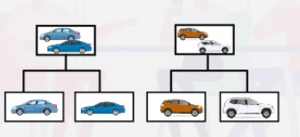

Slide 17
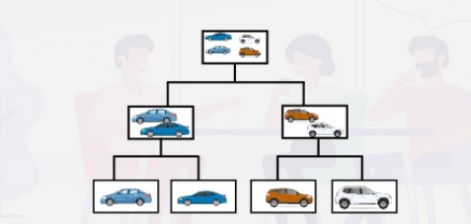

Slide 18
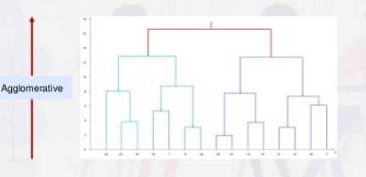
Hierarchical Clustering
Agglomerative(Bottom to Top )

Slide 19
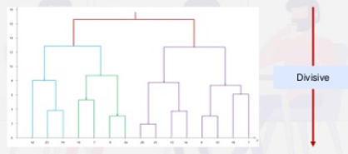
Divisive (Top to bottom) Dendrogram

Slide 20
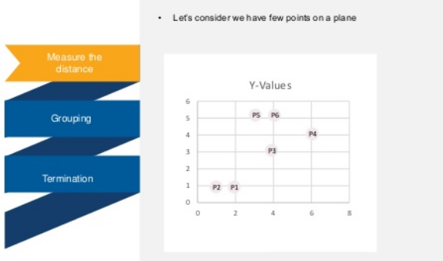

Slide 21
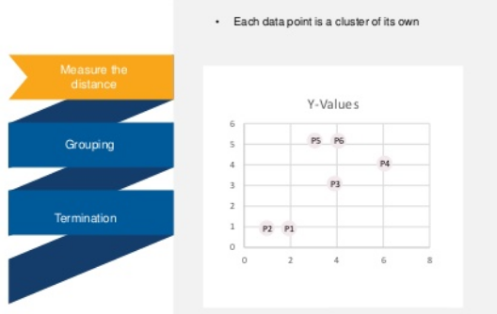

Slide 22
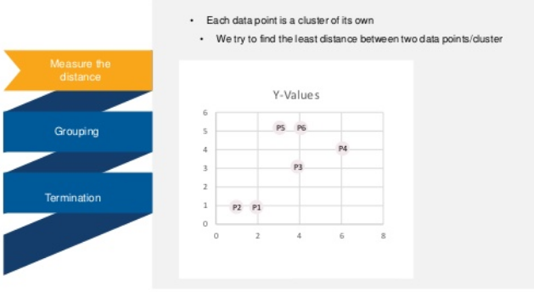

Slide 23
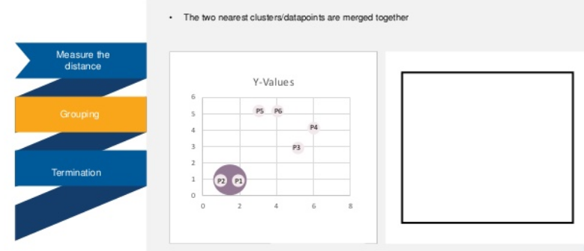

Slide 24
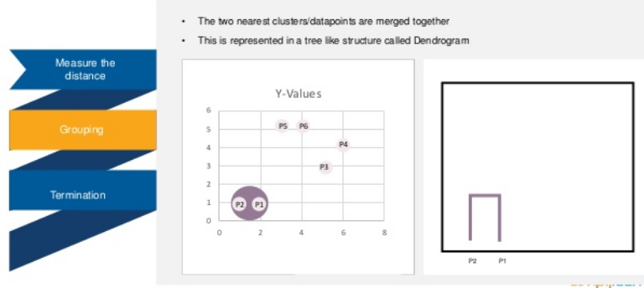

Slide 25
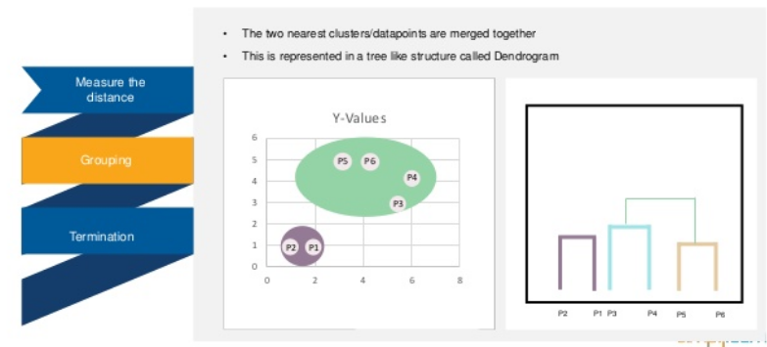

Slide 26
